Slide 1
Netflix Dataset
John Gers and Johnathan Nguyen

Slide 2
NETFLIX README
The movie rating files contain over 100 million ratings from 480 thousand randomly-chosen, anonymous Netflix customers over 17 thousand movie titles. The data were collected between October, 1998 and December, 2005 and reflect the distribution of all ratings received during this period. The ratings are on a scale from 1 to 5 (integral) stars. To protect customer privacy, each customer id has been replaced with a randomly-assigned id. The date of each rating and the title and year of release for each movie id are also provided.

Slide 3
Dataset
Entire dataset contained 17000+ .txt files.
Each file corresponded to its own movie and contained a list of reviews.
Size of list equaled number of reviews for that movie.
Total size of dataset: 1.92 GB

Slide 4
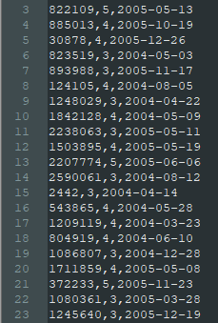
Dataset
Dataset Structure -
UserID
Rating (1-5)
Date

Slide 5
Results
How did we dissect the dataset?
Top 10 Worst Rated Movies/TV Shows by average review score
Top 10 Best Rated Movies/TV Shows by average review score
Top 10 Users/Reviewers by number of reviews

Slide 6
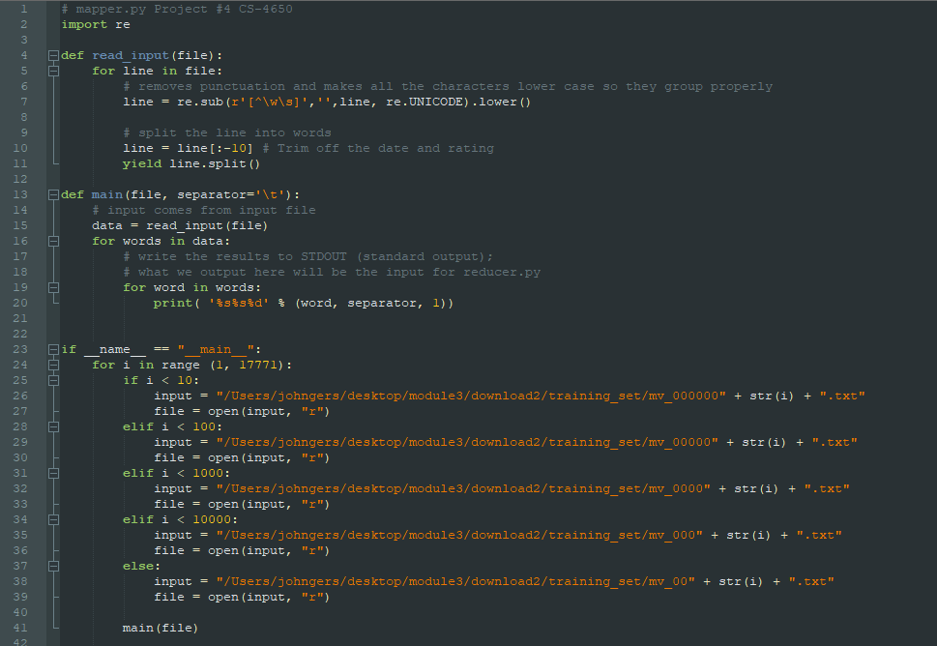
Mapper

Slide 7
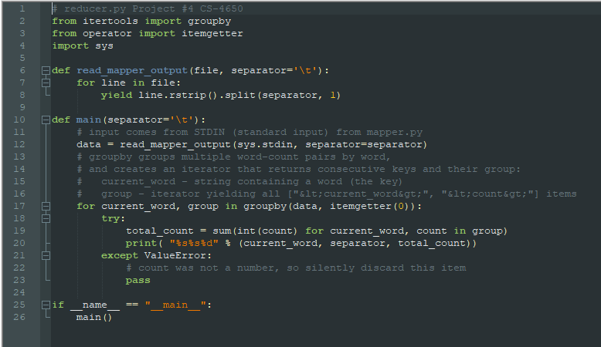
Reducer

Slide 8
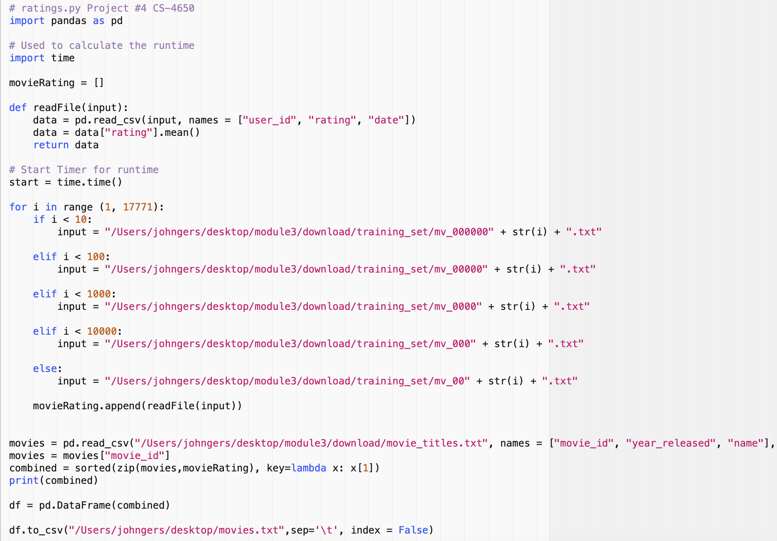
Ratings

Slide 9
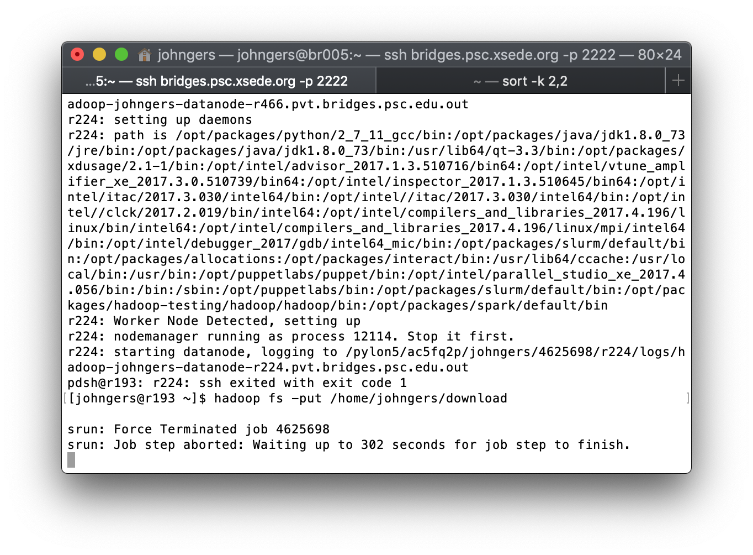
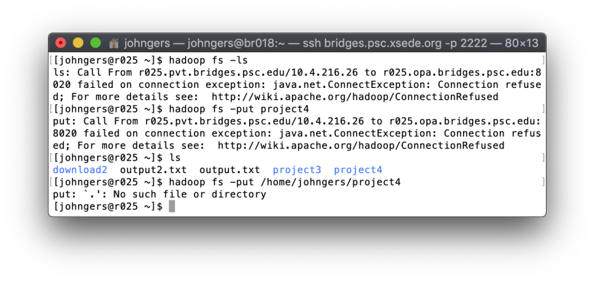
Hadoop Errors

Slide 10
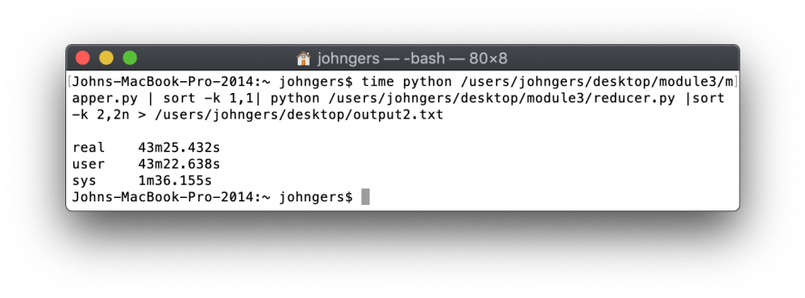
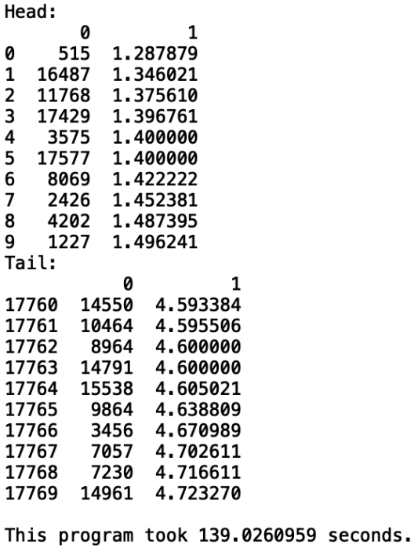
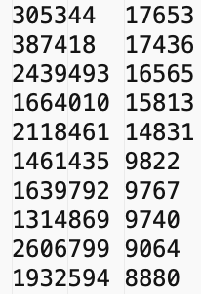
Outputs

Slide 11

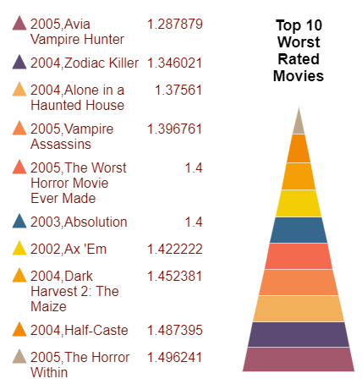

Slide 12



Slide 13
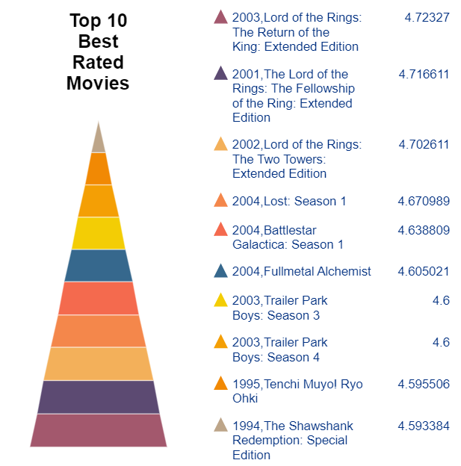


Slide 14
